Slide 1


EPICS REVIEW 2024
Problem Statement Title: Reduction of Energy Consumption and Conservation.
Idea Title : Automatic Auditorium Light System Management
Team Name: THE ELITE
Theme: Sustainable power consumption

Slide 2
Team Details
Team Name: THE ELITE
College Name: Karpagam Institute of Technology
Agalya V Female III ECE 8870629949 21eca05@karpagamtech.ac.in
Akshay K Male III ECE 7448583577 21eca07@karpagamtech.ac.in
Chiradeep M Male III ECE 6374797415 22leca01@karpagamtech.ac.in
DivyaPrashanth M Male III ECE 9486770040 21eca23@karpagamtech.ac.in

Slide 3
Problem Description
The management and control of lighting systems play a pivotal role in enhancing the audience's experience and facilitating a wide range of events.
Traditional lighting systems, often manual or semi-automated, suffer from a lack of flexibility, inefficiency in energy consumption, and the inability to adapt to the diverse requirements of different events.
This project proposes the design and implementation of an auditorium light management system that leverages advanced technologies to offer a comprehensive solution to these challenges.

Slide 4
Your Idea
The AALS is designed with the primary objective of automating the control of lighting within auditoriums.
The system architecture integrates Internet of Things (IoT) components, sensor technologies, and sophisticated software algorithms to enable intelligent control and management of lighting fixtures.
Without involving human intervention we can turn ON and OFF the lights automatically.

Slide 5
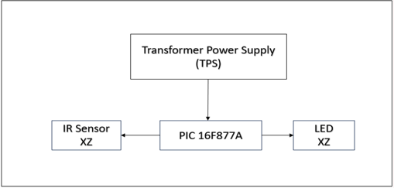
Pictorial Representation of the Idea

Slide 6
Technology Stack
Components used in projects are:
Step – Down transformer
LEDs
IR sensors
Microcontroller(pic16F877A)
Resistors

Slide 7
Implementation
IR sensor/Industrial Ultrasonic sensors can be used at the entrance of the auditorium to detect the count of the persons entering and getting out the place.
On based of the count the lights will turn ON and OFF automatically.The same way it may also applicable to Fans .

Slide 8
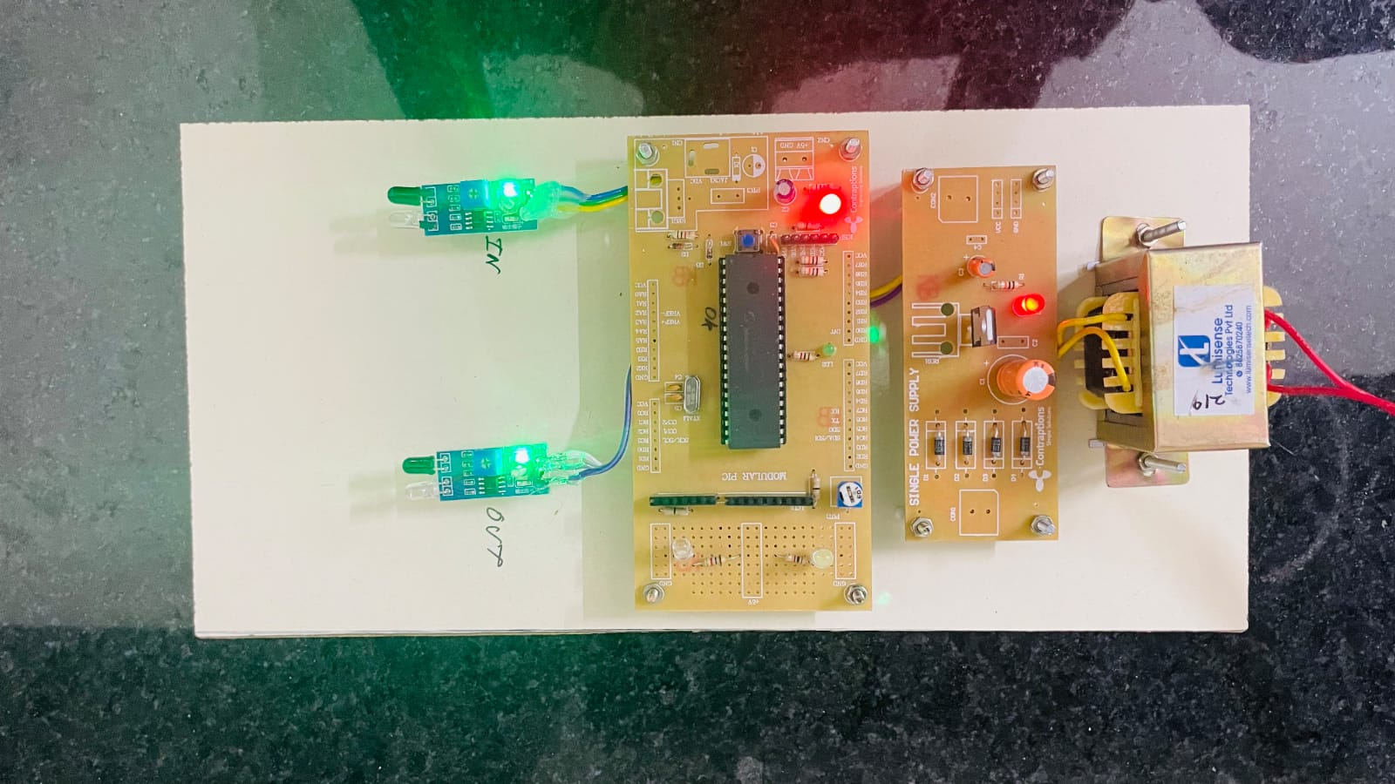
Demo/Output

Slide 9
Social Benefits
Man power is reduced
Time consumption
Cost –efficient
Easy to Install
Effortless to manage

Slide 10
Commercial Viability
AALS can be improved and enhanced by using machine learing and image processing techniques.
For example , an Auditorium that’s already fixed with a camera and its frame rate, resolution are high so that we can use the existing camera’s feed.
The Logitech C920 HD Pro Webcam is a cost-effective device that provides 1080p video quality and is appropriate for various tasks such as facial recognition and basic object recognition.

Slide 11
Conclusion
The auditorium light system management project successfully optimized energy usage, enhanced user experience through customizable lighting presets and improved overall operational efficiency by implementing smart sensors.
THANK YOU

